Slide 1
SRVUSD Strategic Directions
June 15, 2021

Slide 2
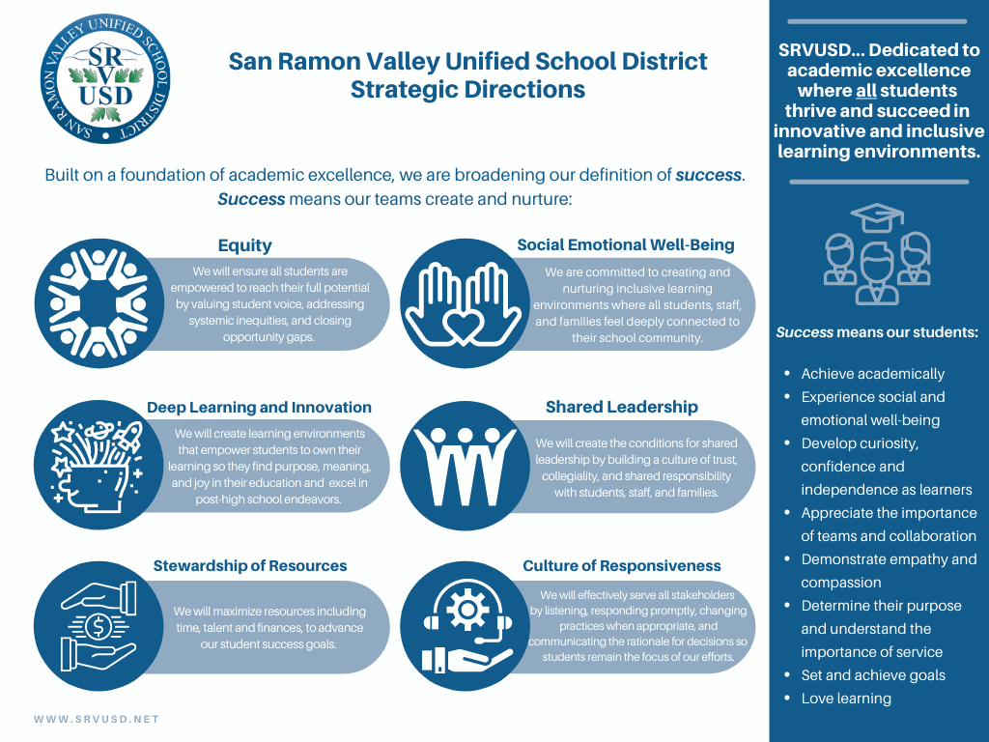
Strategic Directions Overview

Slide 3
ThoughtExchange
Participants:
131
_____
Thoughts Shared:
52
_____
Ratings:
1657
Reopened
June 1 - 10, 2021
for feedback on the DRAFT plan

Slide 4
Key Comments
Smaller class sizes
Equity must include students with special education needs
Need greater details about Deep Learning
Need more specificity on Social Emotional programs

Slide 5
Key Comments
Reach out to underrepresented groups
Develop more career exploration/jobs placement opportunities
Quantity of work should not take the place of quality of work
When hiring for diversity, be sure to represent all

Slide 6
Key Comments
Challenges in terms of equitable funding
Emphasize group work and teams
Parents must factor more into things
  Oversight committees
  Communications plans
Publicize measurable goals

Slide 7
Concerns that were communicated
Academic excellence will be minimized
Actions related to equity and inclusion
  Moving too slowly
  Moving too quickly

Slide 8

Our Commitments...

Slide 9

Academic Excellence remains our priority
Emphasized at the beginning of the document

Slide 10
Equity & Inclusion and
Social Emotional Well-Being are needed for academic excellence to remain

Slide 11
All our students, staff and community are included in our commitment to equity and inclusion - including those with special education needs

Slide 12
We will continue to define Deep Learning
Supports our commitment to academic excellence

Slide 13
We will ask our school sites to continue to engage their communities regarding Social Emotional Well-Being programs that will be used at their sites

Slide 14
Measurement of progress will be made at the District, School Site and Department levels
Clarified by January 2022 - after we have had more time to engage our community between August and January.

Slide 15
The importance of Career and Technical Education is included in the plan

Slide 16
Continuous Improvement Cycle will include parents and students with our staff

Slide 17
Transformational change requires cultural shifts...

Slide 18
Cultural Shifts
Broadening definition of success while maintaining high standards for academic achievement
Strengthening and enhancing shared leadership and responsiveness
Prioritizing equity and inclusion as a condition for all students’ success
Changing instruction, assessment, and intervention strategies as necessary to support the strategic directions

Slide 19
Next Steps
Develop a facilitated process
  Will be used by every site and department between August and January
Finalize District committees and processes
  To support the Strategic work
Bring a report back to the Board:
  November 16, 2021
  January 18, 2022

Slide 20
What we will continue to work on
Start the 21-22 school year differently
Continue our work on multi-tiered systems of support and grading, and structured literacy
Continue examining issues of access to the instruction, programs, and interventions our students need
Provide facilitated equity learning opportunities for all staff
Implement the components of the Responding to Discrimination and Hate Handbook
Strengthen our reporting mechanisms when issues of discrimination occur

Slide 21
Thank you to all stakeholders for your engagement in this process
Have a great summer break!
Next Board of Education meeting:
August 3, 2021 (am meeting)

